Slide 1
Infrastructure Cloud Computing
https://github.com/siagianp
https://www.youtube.com/@AmelOline/videos
https://github.com/amelcharolinesgn2/Cloud-Infrastructures
https://github.com/amelcharolinesgn2/ClouD-Infrastructure-SISKA-2025
https://github.com/amelcharolinesgn2/CCNA1
@Amel charoline & Irene M
https://github.com/amelcharolinesgn2/CCNA2
https://github.com/amelcharolinesgn2/AWS Certificate

Slide 2
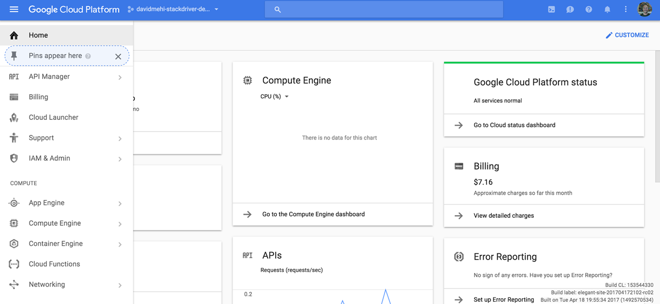
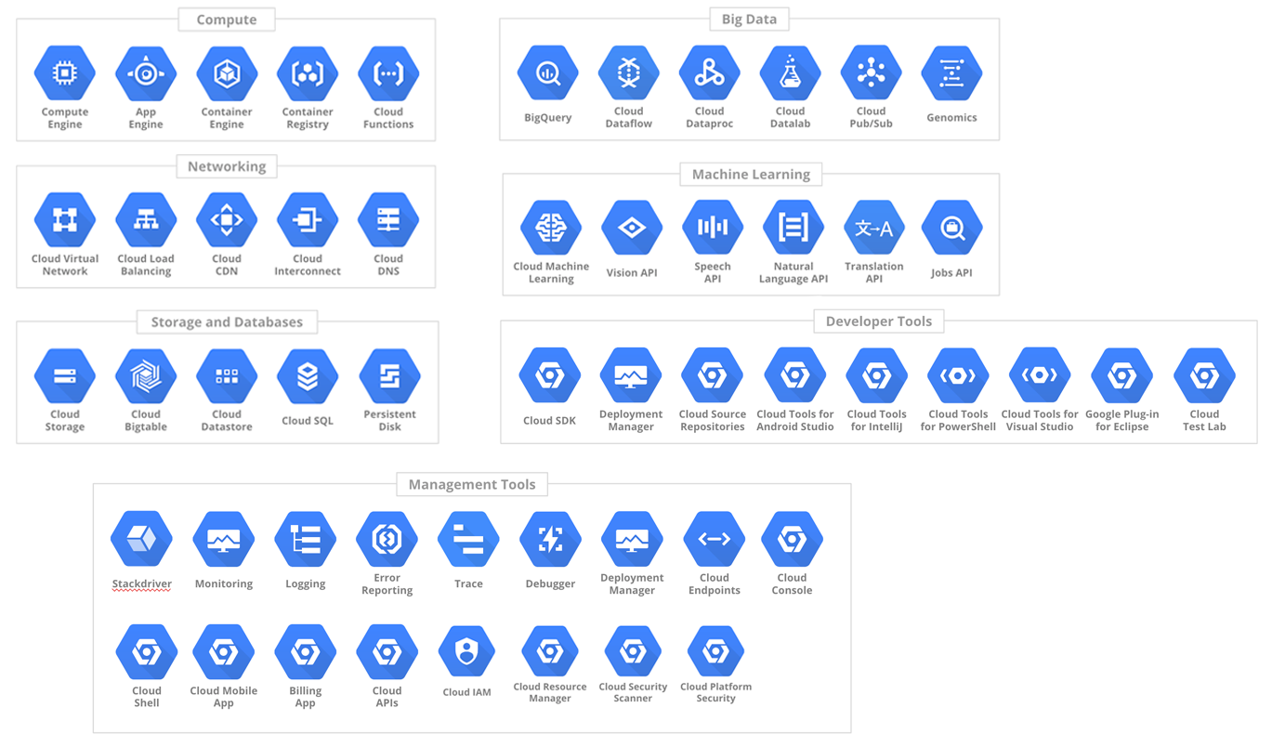
GCP
Navigating GCP
Computing
Networking
Storage
Big Data
Administration
Development
Machine learning
Notes:
I’m an Application developer at heart, so I’ll start with Computing and Storage. If you got questions, here’s your best opportunity for coherent answers from me. I’ll talk about Big Data here, but it’s not my area of focus, so expect C+ answers here.
Then I’ll talk about Networking, Operations. Answers to questions here: eh.
I’ll finish in Development, with a brief sojourn into Machine learning.

Slide 3
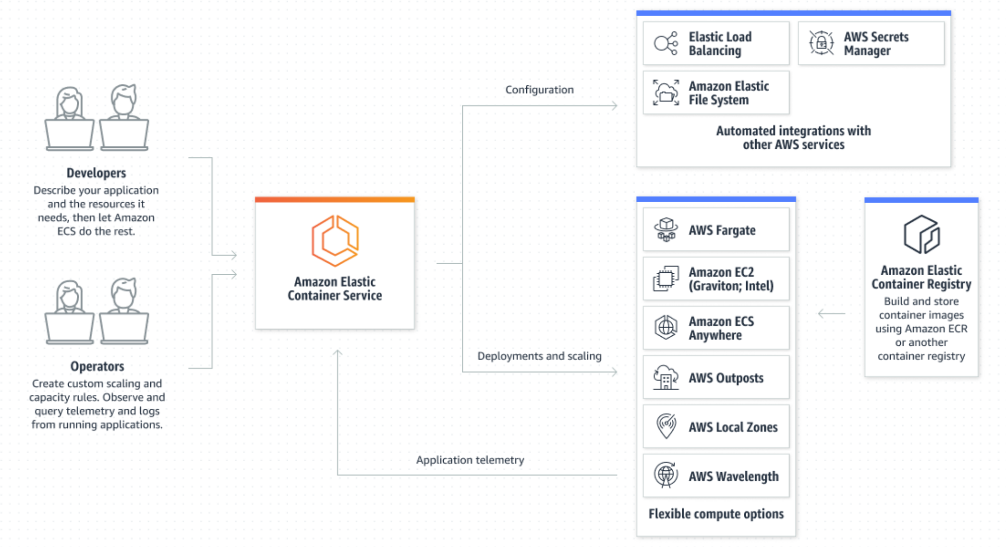
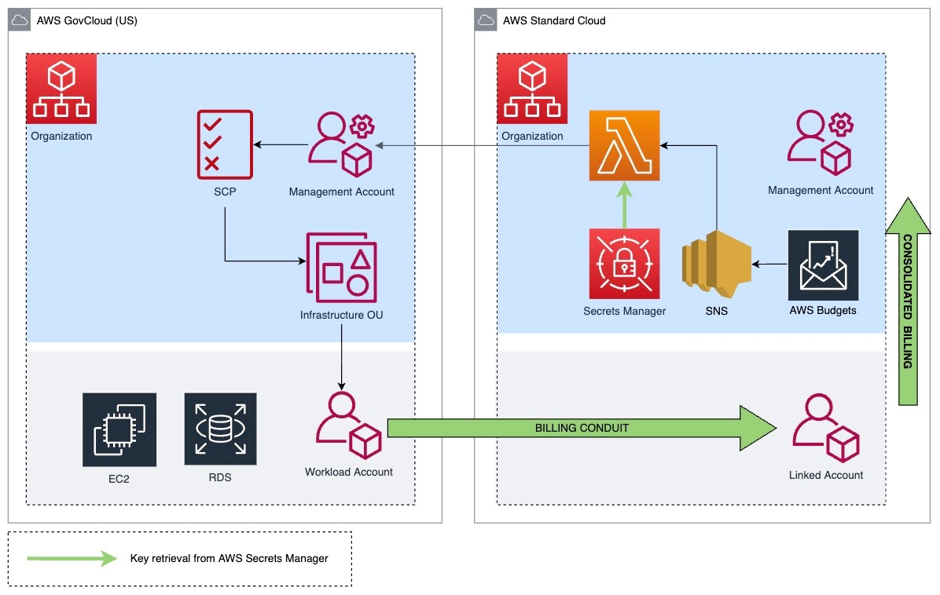
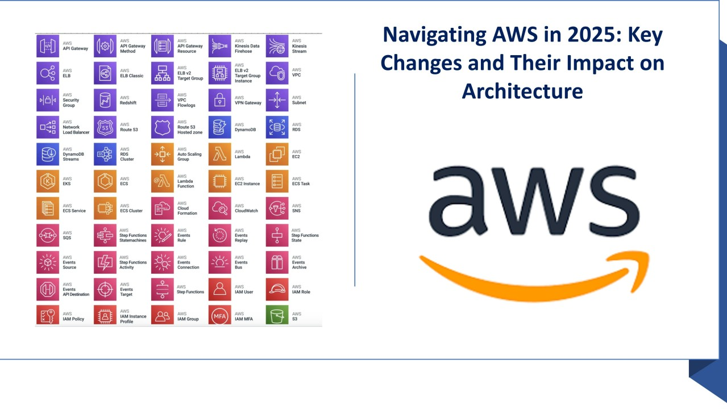
AWS
Navigating AWS
Computing
  Elastic Compute Cloud (EC2)
Storage
  Simple Storage Services (S3)
  Elastic Block Stores (EBS)
  Glaciar
  DynamoDB
Other services
  Simple Queue Service
Ec2 Machine
​Storage on AWS
Scalable system
​Deployment
​Security
Price optimization
Notes:
I’m an Application developer at heart, so I’ll start with Computing and Storage. If you got questions, here’s your best opportunity for coherent answers from me. I’ll talk about Big Data here, but it’s not my area of focus, so expect C+ answers here.
Then I’ll talk about Networking, Operations. Answers to questions here: eh.
I’ll finish in Development, with a brief sojourn into Machine learning.
- **AWS Core Services** → EC2, VPC, RDS, EBS, S3, IAM, CloudFormation, CloudWatch- **Serverless** → Lambda, SQS, SNS, Cognito- **Containers** → ECS- **Networking** → ALB, NAT, Multi-AZ, VPC- **Automation** → IaC with CloudFormation- **Monitoring & Cost Optimization**---
AWS Core Services → EC2, VPC, RDS, EBS, S3, IAM, CloudFormation, CloudWatch
Serverless → Lambda, SQS, SNS, Cognito
Containers → ECS
Networking → ALB, NAT, Multi-AZ, VPC
Automation → IaC with CloudFormation
Monitoring & Cost Optimization
https://github.com/saravana0702/aws-lab

Slide 4
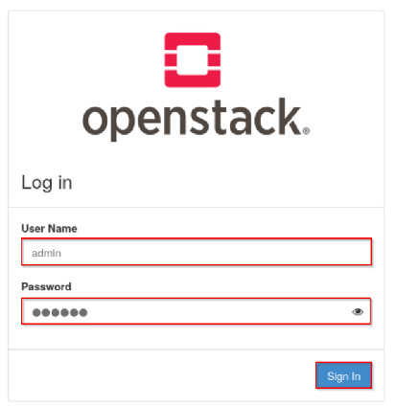
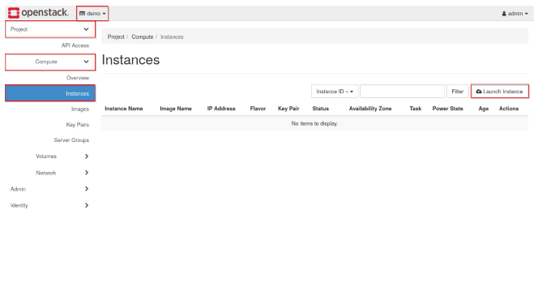
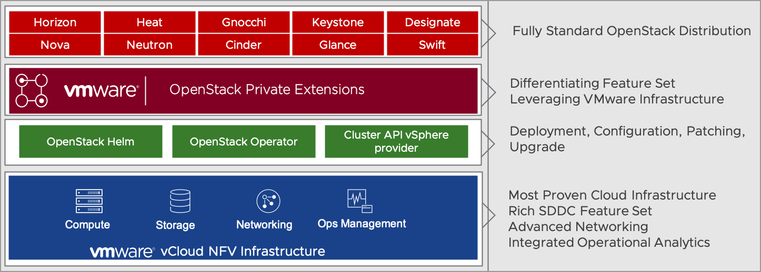
Openstack
OpenStack services installed on Controller node:
Keystone
Horizon
Glance
Nova:
nova-api
nova-scheduler
nova-consoleauth
nova-cert
nova-novncproxy
python-novaclient
Neutron:
neutron-server
Cinder
Openstack services installed on Network node:
Neutron:
neutron-plugin-openvswitch-agent
neutron-l3-agent
neutron-dhcp-agent
neutron-metadata-agent
Openstack Services installed on Compute node:
Nova
nova-compute
Neutron
neutron-plugin-openvswitch-agent
How to access the services
There are two ways to access the services:
OpenStack Dashboard (horizon)
You can access the dashboard at: http://192.168.100.51/horizon
Admin Login:
Username: admin
Password: admin_pass
Navigating OpenStack
Keystone
Horizon
Glance
Nova
Neutron
Cinder
Notes:
https://github.com/openstack
https://people.redhat.com/mlessard/mtl/presentations/oct2013/OpenstackOverview.pdf
https://github.com/mikeroyal/OpenStack-Guide
https://github.com/citil/sample-labs/tree/master
https://github.com/nexus-lab/openstack_labs/tree/main/lab2
https://github.com/nexus-lab/openstack_labs/blob/main/lab7/OpenStack_Lab_07.pdf
OpenStack services installed on Controller node:
Keystone
Horizon
Glance
Nova
nova-api
nova-scheduler
nova-consoleauth
nova-cert
nova-novncproxy
python-novaclient
Neutron
neutron-server
Cinder
Openstack services installed on Network node:
Neutron
neutron-plugin-openvswitch-agent
neutron-l3-agent
neutron-dhcp-agent
neutron-metadata-agent
Openstack Services installed on Compute node:
Nova
nova-compute
Neutron
neutron-plugin-openvswitch-agent
How to access the services
There are two ways to access the services:
OpenStack Dashboard (horizon)
You can access the dashboard at: http://192.168.100.51/horizon
Admin Login:
Username: admin
Password: admin_pass

Slide 5
Lab1 - set up the playground and install basic infrastructure services
Lab2 - Install Keystone
Lab3 - Install Glance and Placement
Lab4 - Install Nova
Lab5 - Install Neutron in a very basic setup (one flat network only)
Lab6 - Add the Horizon GUI
Lab7 - Add a VLAN network as a provider network
Lab8 - Install a virtual router using the Neutron L3 agent
Lab9 - Allow a tenant to provision VXLAN networks
Lab10 - Introduce a separate network node on which the Neutron agents run
Lab11 - Play with iSCSI
Lab12 - LVM playground
Lab13 - Install Cinder
Lab14 - Octavia as stand-alone loadbalancer
Notes:
https://github.com/christianb93/openstack-labs/blob/master/Lab9/Vagrantfile
https://github.com/christianb93/k8s-on-openstack

Slide 6
HW 3 #
Dari ketiga Infrastructure Cloud Computing
Buatkan Arsitektur tersebut terdiri Dari (Computing, Networking, Storage, Development)
Uraikan
Notes:
This is a little harder than it looks. Cause here is how we typically list these.
There are over 50 products on this slide. We bunch them up and try to make them fit themes. But at the end of the day, almost everyone of these is can be an hour or several hours of talks. I’m trying to scrunch in.
Everyone in this room, probably has A problem that can be solved by something on this chart, but none of you will have all of the same issues, or end up with the same products. You probably will only need to deal with a fraction of it.
Which is why when you go to cloud.google.com, it can feel like overload.
Which is why I’m giving this talk
I won’t name everything. Why?
Was it that I couldn’t fit everything? Maybe.
Is it cause I’m not an expert in all of it? Probably.
Did the keynote give a lot of love to our big releases? Definitely.
Am I doing that thing where I ask questions then answer them myself? Absolutely.
8 Compute
10 data and storage
9 Networking
6 Administration
5 Developer
5 Services
43 talked about
53 on slide.

Slide 7
Signing Up
Getting started
Notes:
Okay, computing, you know, doing things, analyzing or sorting stuff.

Slide 8
Getting Started
Signing Up
Notes:
I’m an Application developer at heart, so I’ll start with Computing and Storage. If you got questions, here’s your best opportunity for coherent answers from me. I’ll talk about Big Data here, but it’s not my area of focus, so expect C+ answers here.
Then I’ll talk about Networking, Operations. Answers to questions here: eh.
I’ll finish in Development, with a brief sojourn into Machine learning.

Slide 9
Sign up demo
Let’s get an account
Notes:
Determine if you have time. If you do:
VM screen
Create VM
SSH into it.

Slide 10
References

